Slide 1

Shopping List Management Application
Android Project
- Smith Dabreo (8382)
- Brian Dias (8384)

Slide 2
Why is a Shopping app necessary?

Slide 3
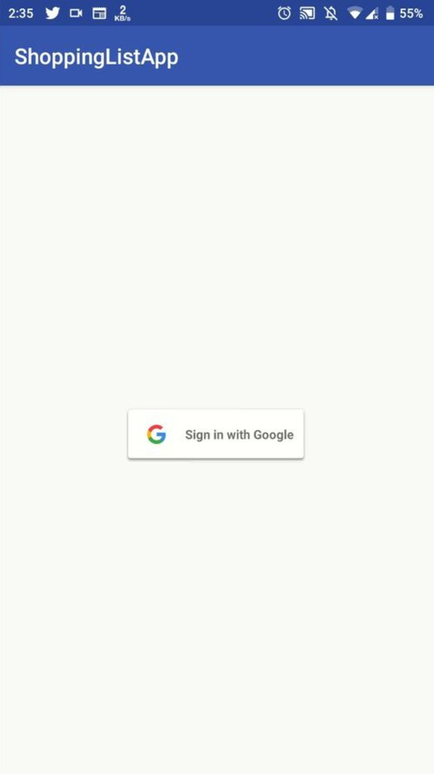

Widgets
Widgets are an essential aspect of home screen customization. One can imagine them as "at- a glance" views of an app's most important data and functionality that is accessible right from The user's home screen.

Slide 4
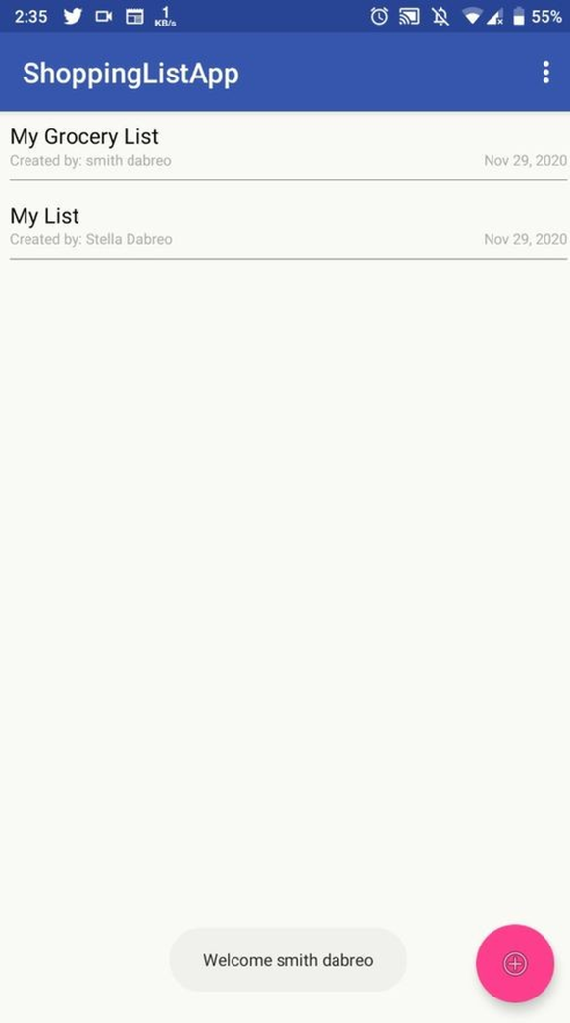
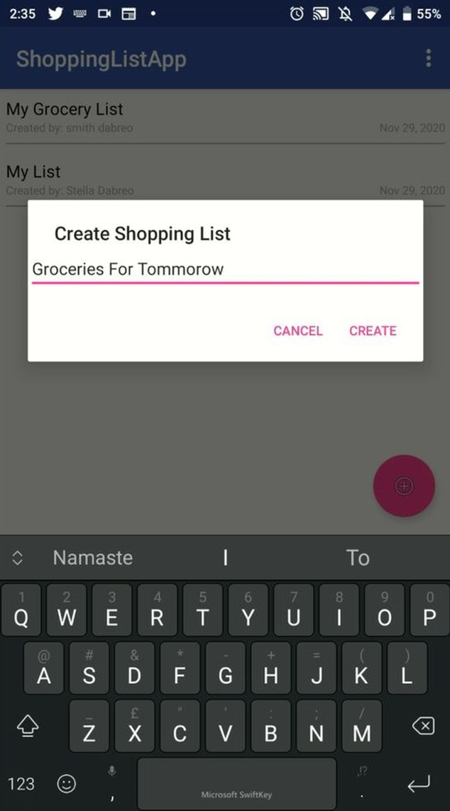
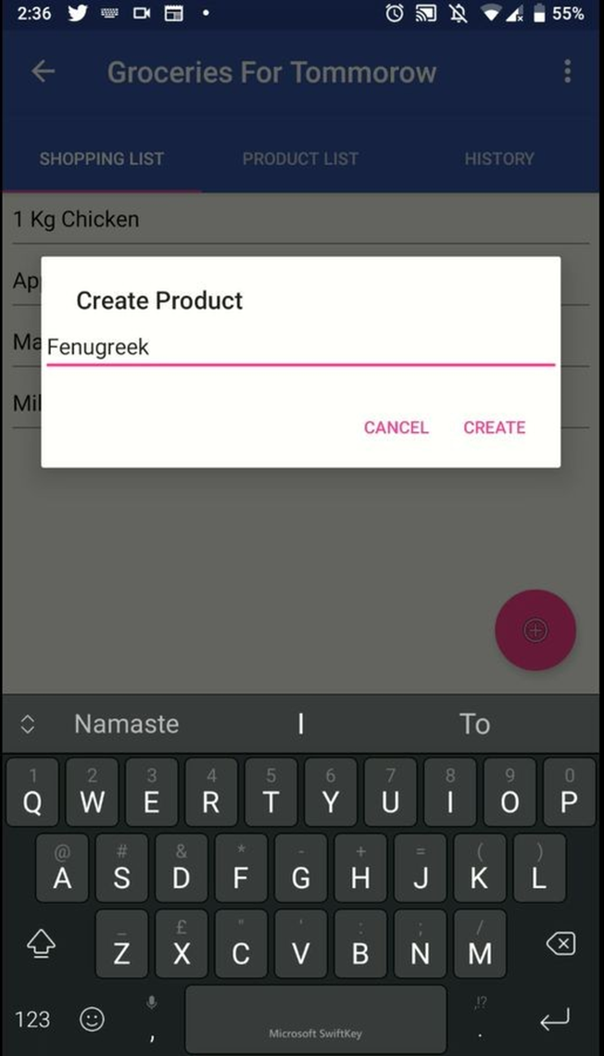
Layouts
A Layout dictates the alignment of widgets (such as Text, Buttons, EditText box) as we see in the Android Application. All the visual structure we see in an android app is designed in a Layout. Every Layout is defined in an xml file which is located in App > res > Layout in New Android Studio.

Slide 5
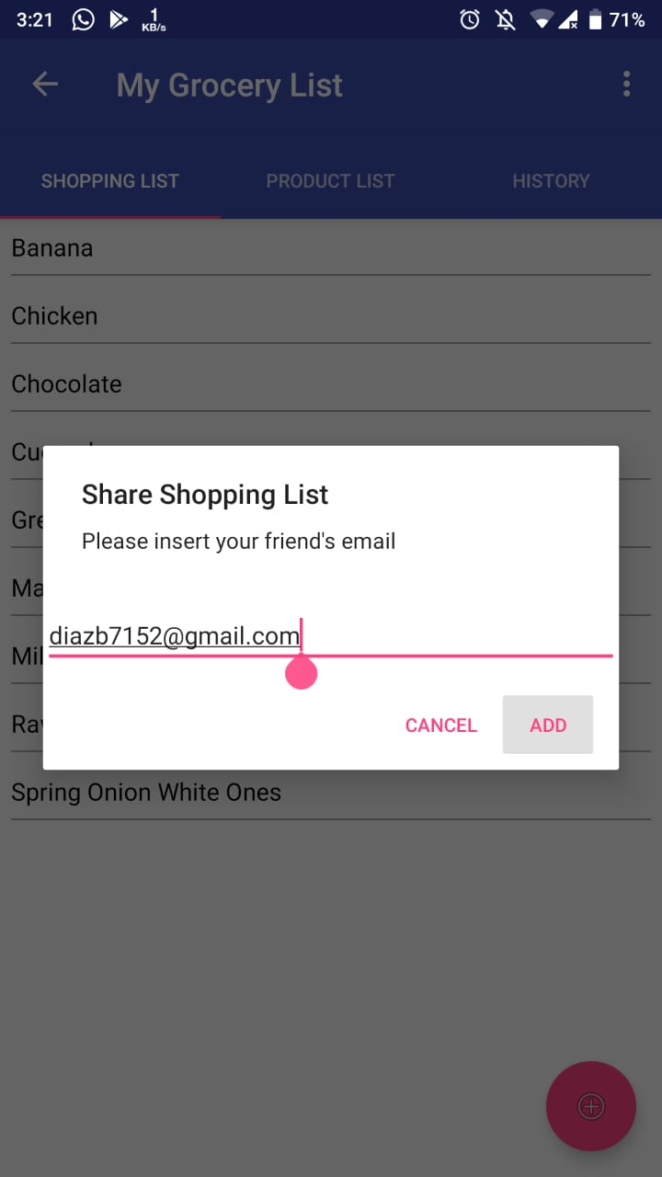
Intents
Android Intent is the message that is passed between components such as activities, content providers, broadcast receivers, services etc.
It is generally used with startActivity() method to invoke activity, broadcast receivers etc.
There are two types of intents in android: implicit and explicit. Implicit Intent doesn't specify the component. Explicit Intent specifies the component.

Slide 6
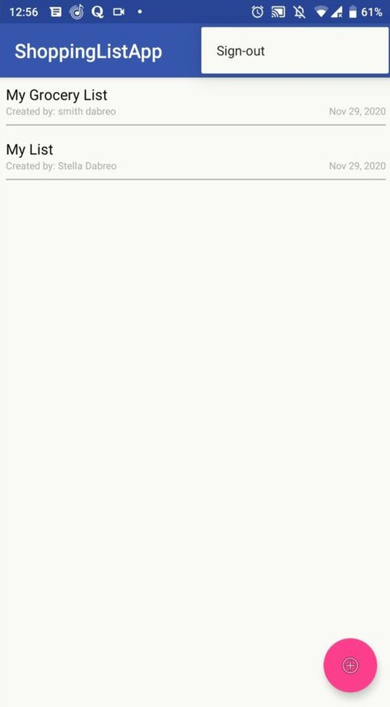
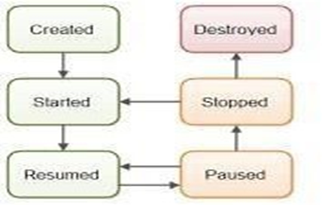
Activity
An activity is the single screen in android.
It is like window or frame of Java.
By the help of activity, you can place all your UI components or widgets in a single screen.
All activities in your Android apps are represented by an activity class.
Activity Life Cycle:

Slide 7
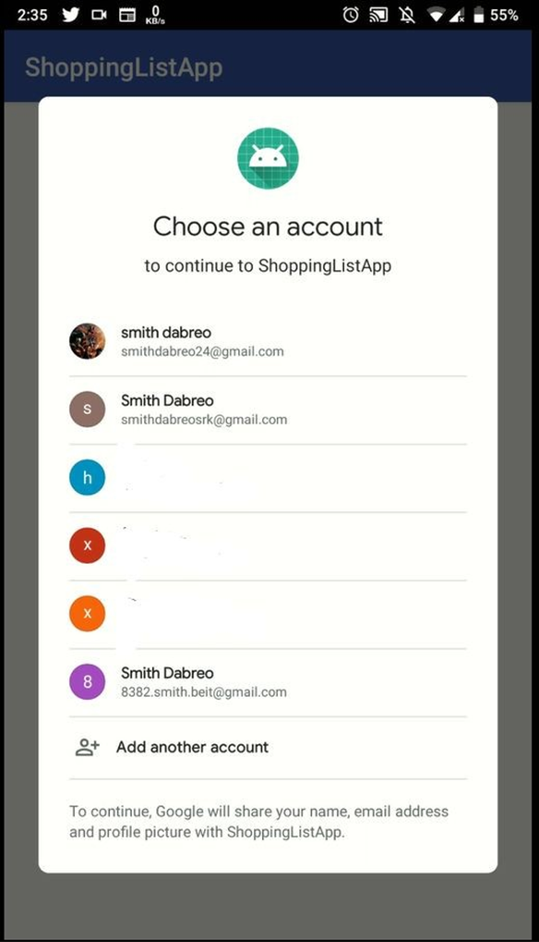
API
API stands for “application program interface.” In short, this allows developers to access the platform or application of another party
Google SignIn API:
Firebase enables users with Google's Sign In API.
This API makes process of authenticating users very easy and all the necessary info like the email is stored using this API for future uses.
This makes the App more secure and users are authenticated via their Gmail accounts. Making it more accessible for user as well as the developer.

Slide 8
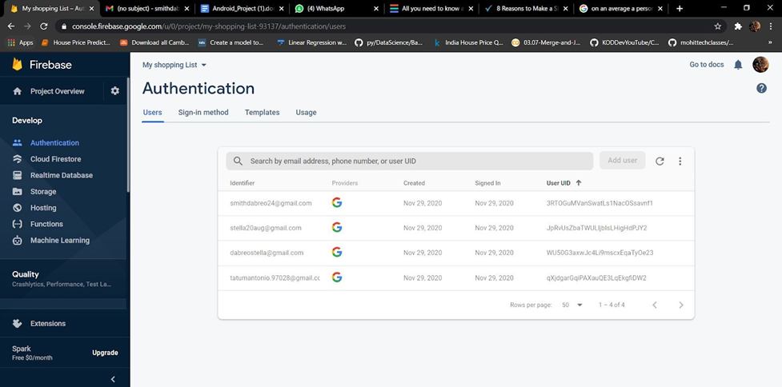

Slide 9
Database Connectivity:
To implement database we have used Google Firebase.
Firebase is a mobile- and web application development platform, backed by Google, to help developers deliver richer app experiences.
Firebase manages its own infrastructure with a nice set of tools to simplify the workflow of the developer by providing them with development kits and an online dashboard.
These toolkits are interconnected, scalable and integrable with third party software to overcome complex challenges with standard building blocks.

Slide 10
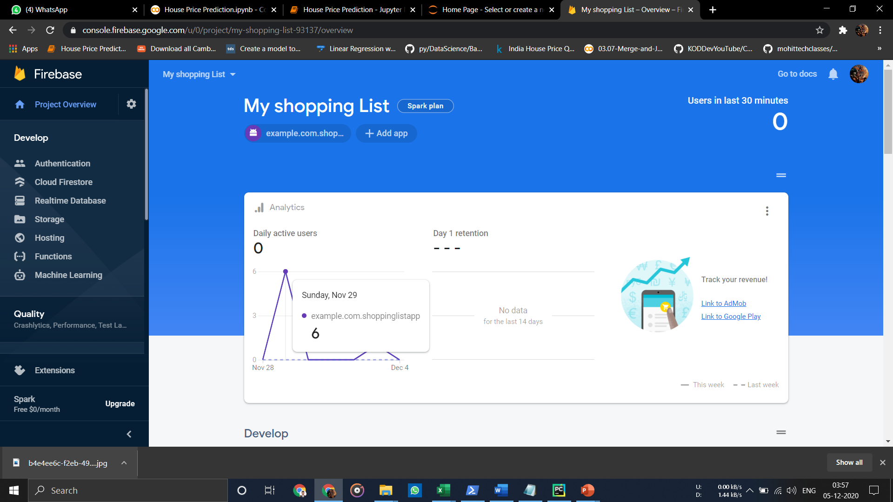
Dashboard

Slide 11
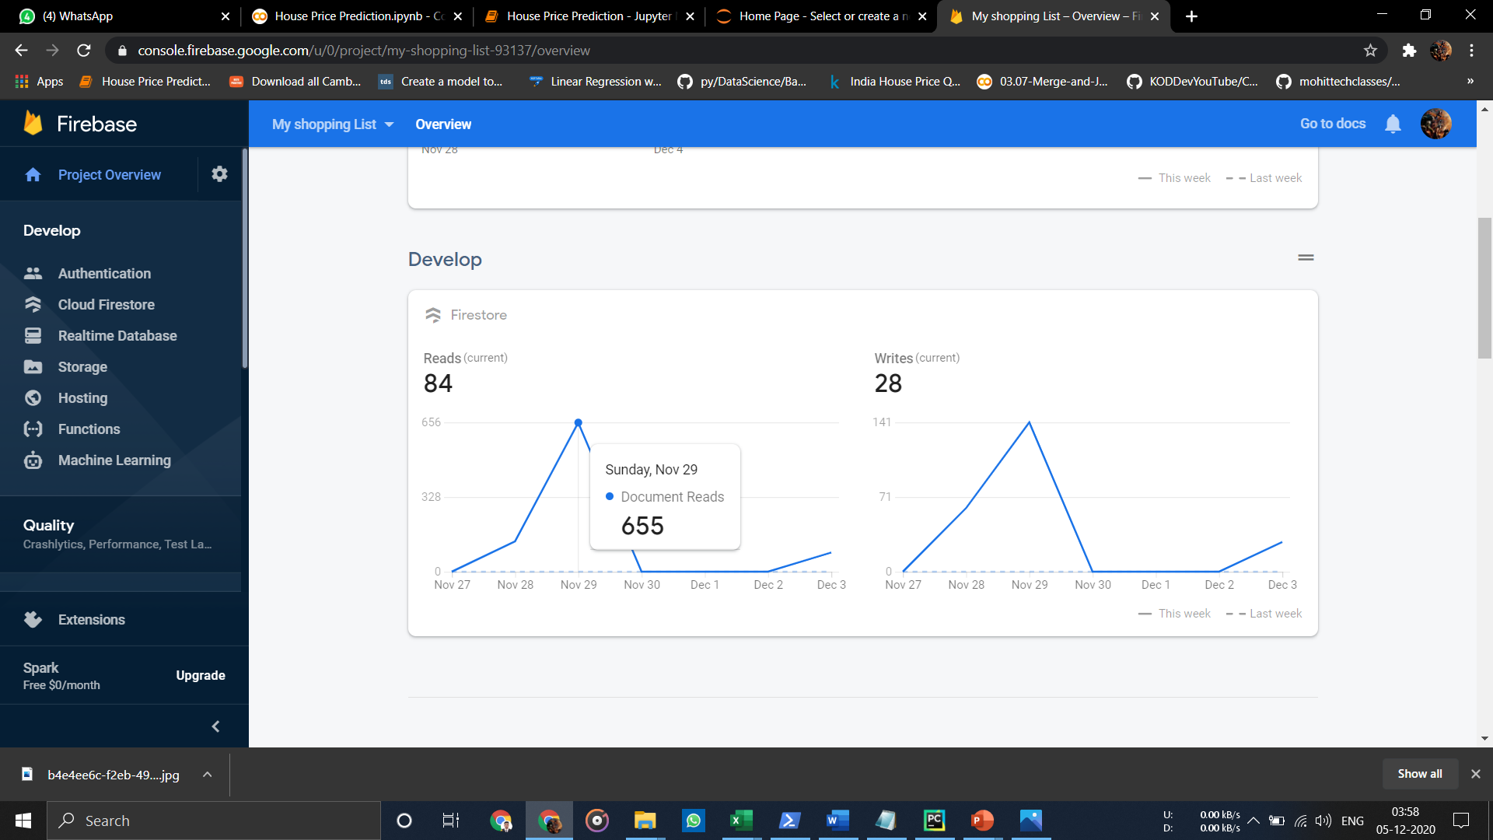

Slide 12
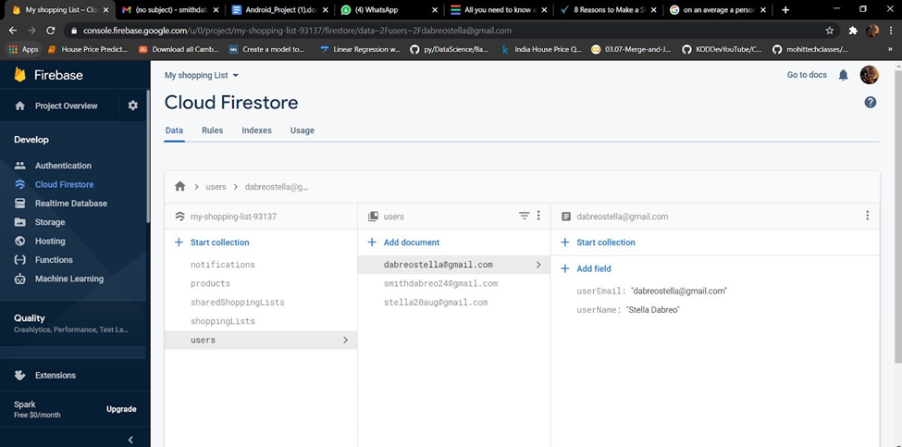
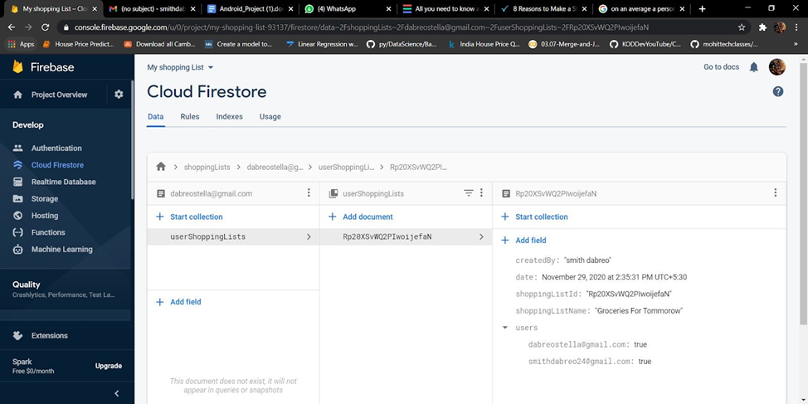
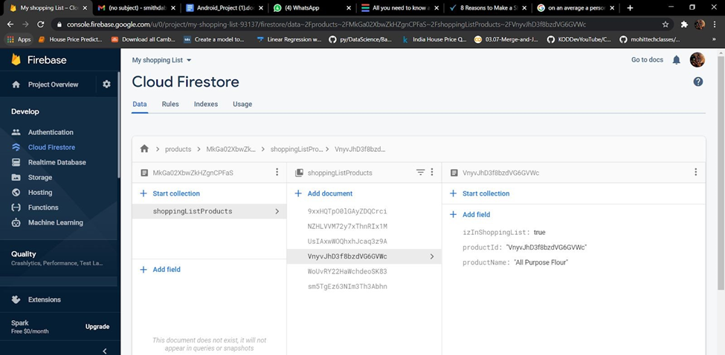
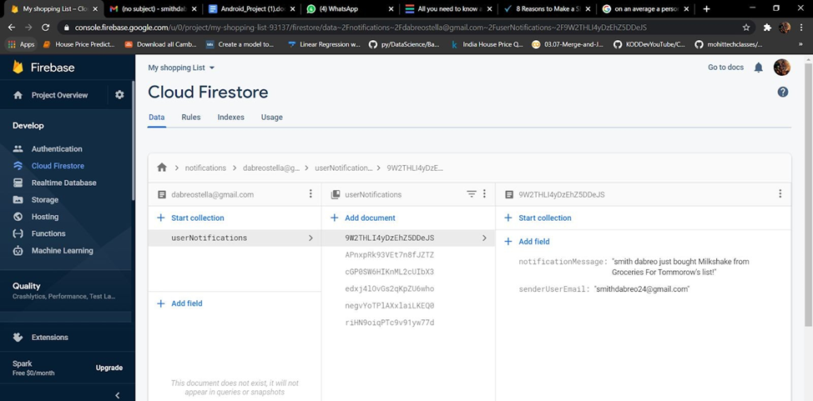

Slide 13
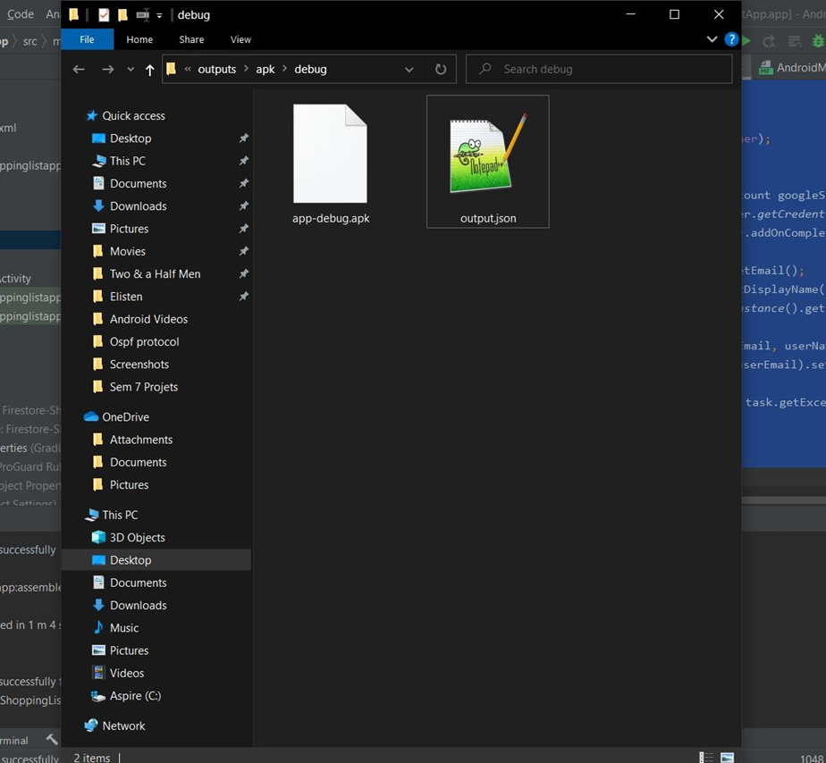
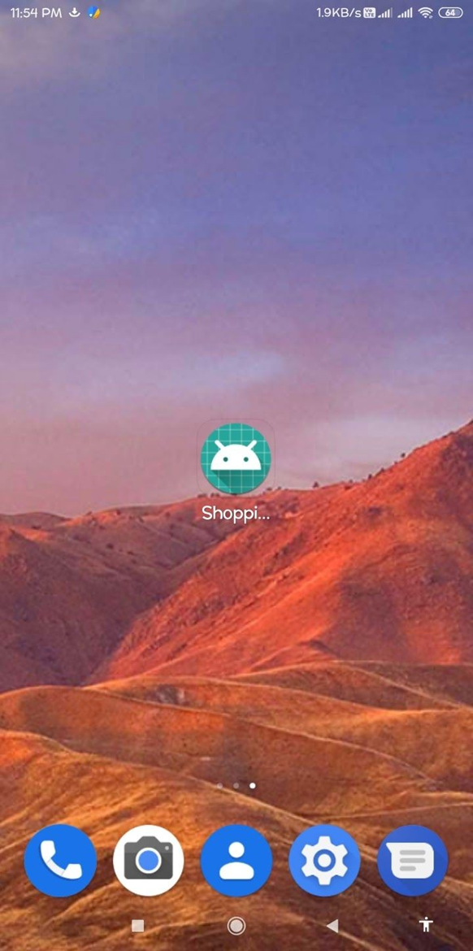
Generating APK
After installing the Shopping List Apk on an android phone, the app will appear as an icon on the home screen.

Slide 14

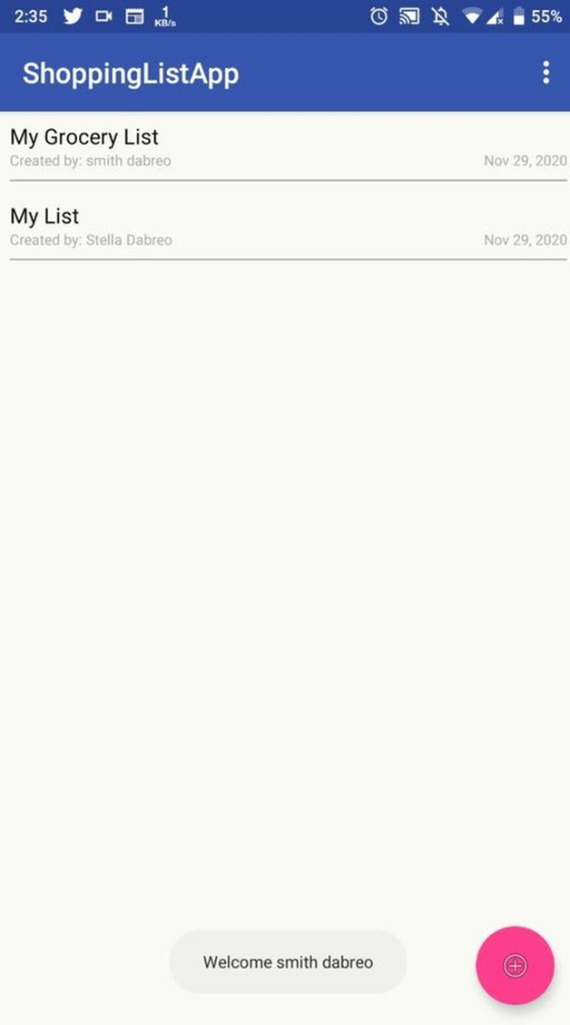
Results
1. Sign In:

Slide 15

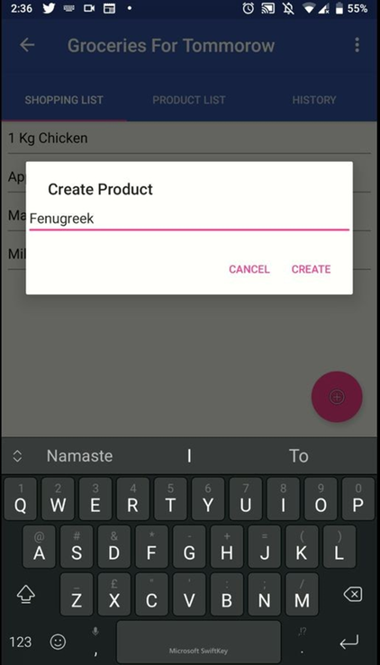
2. Creating a list:
3. Creating Products:

Slide 16
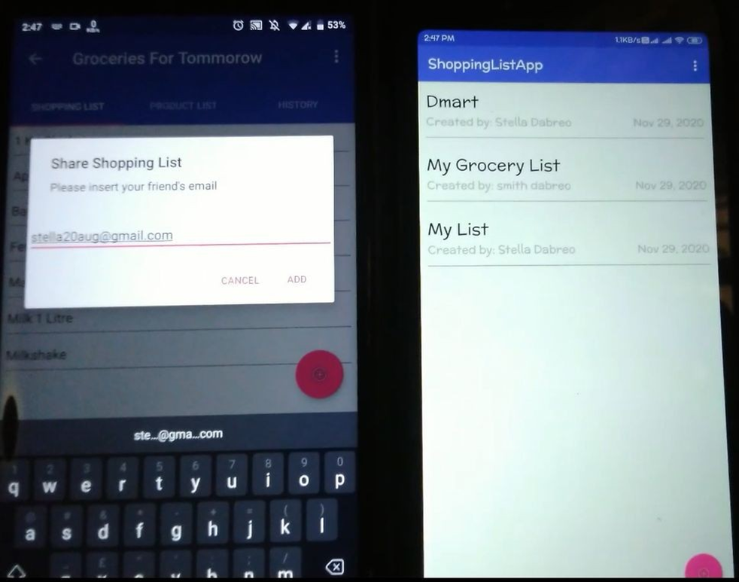
4. Sharing the list:

Slide 17
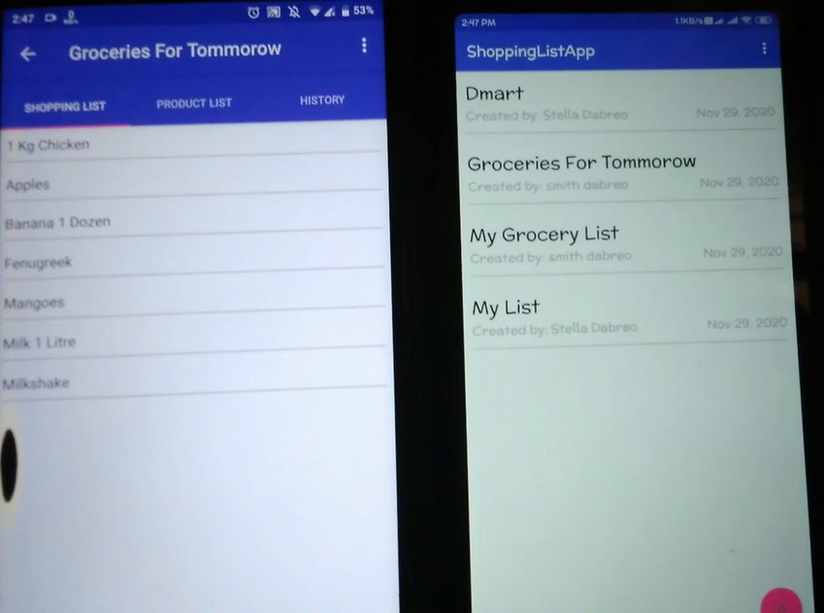
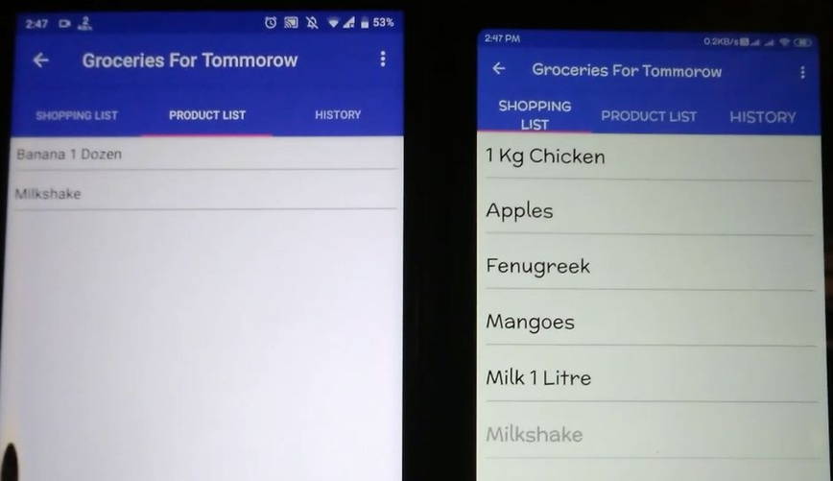

Slide 18
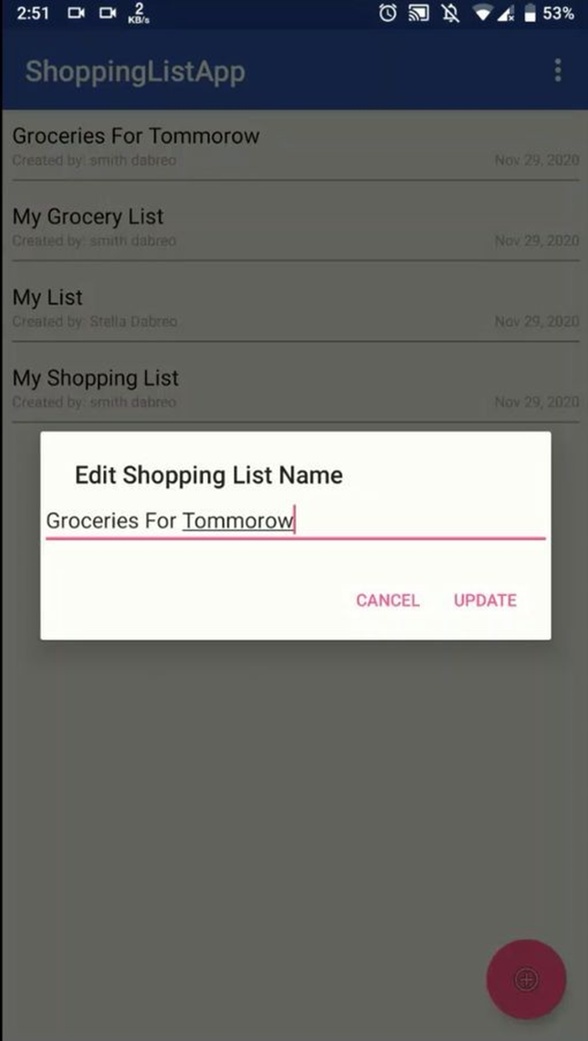
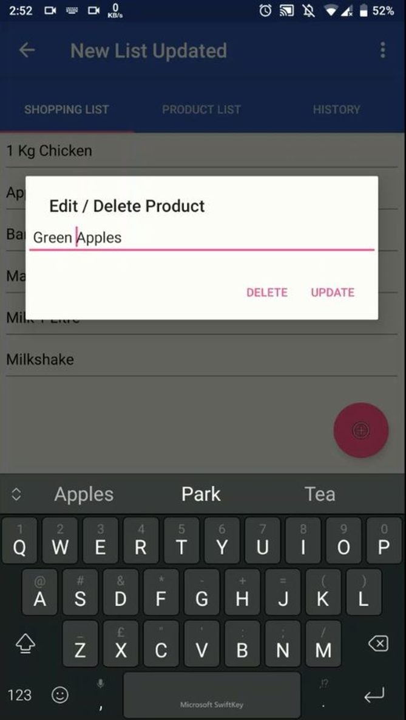
4. Editing/Deleting the List/Products:

Slide 19
Conclusion
Digital Shopping Lists are considered a more reliable and accurate alternative to the conventional lists which waste paper and other resources for just a simple reason. This simple yet effective solution is needed to help people and their lifestyle. Everything should go digital like shopping lists as this world is evolving into a digital world in this internet era. This can help even help people with Alzheimer and other memory related disease, someone can just make a list for them and then they don't have to worry about forgetting anything as everything is safe and secure in the application. Additionally, it is extremely versatile and scalable.

Slide 20
Thank You

